Slide 1
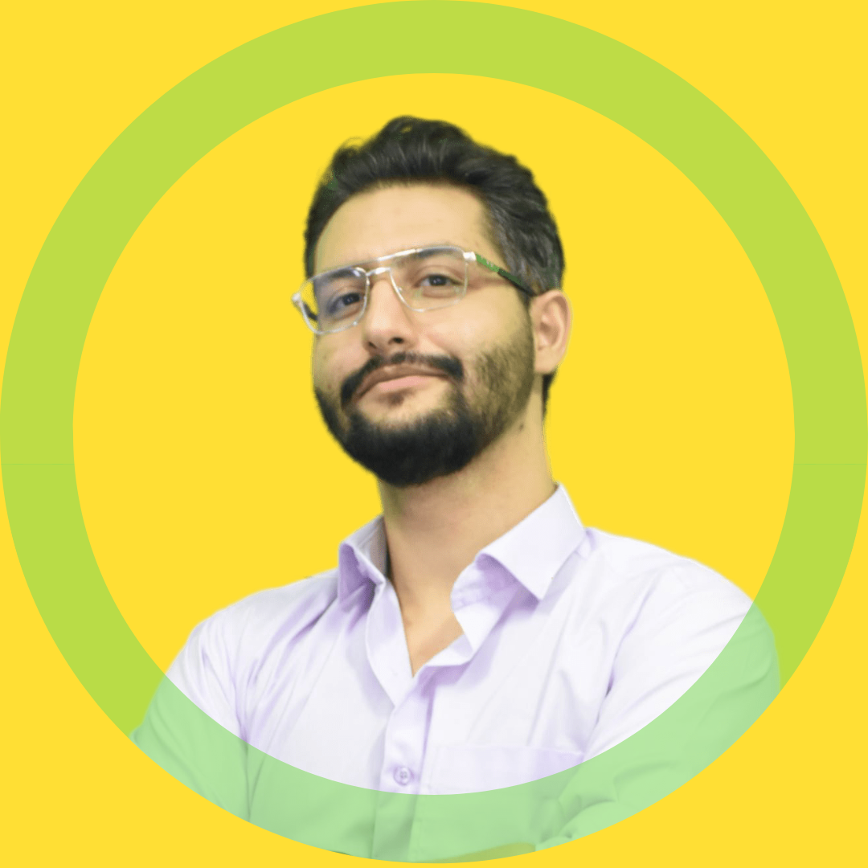


























M. SINA
https://www.linkedin.com/in/msinamsina/
https://github.com/msinamsina
ALLAHKARAM
msinamsina@gmail.com
Computer Vision Expert
Full stack Developer
Roboticist
09981075065
https://msina.me
PROFILE
LANGUAGES
As an expert Python programmer with over 7 years of experience in working on various Computer Vision tasks, as well as web and desktop application development, I am now ready to apply my expertise to your projects.
Persian
Native
English
Fluent
EDUCATIONAL BACKGROUND
HARD SKILLS
Master's degree | K. N. Toosi University of Technology Mechatronics, Engineering 2019-2023
Thesis Title: Development of an image-based deep neural network for human parsing for human behavior classification
Python
Computer Vision
Deep Learning
Git
Bachelor's degree | K. N. Toosi University of Technology
Electrical and Electronics Engineering 2014-2019
Thesis Title: Hardware implementation of motion estimation function in H.264 video encoder
Linux
Embedded Sys.
Clean Code
SW Architecture
FRAMEWORKS & LIBRARIES
SOFT SKILLS
Teamwork
Problem Solving
Django
Leadership Skill

Slide 2


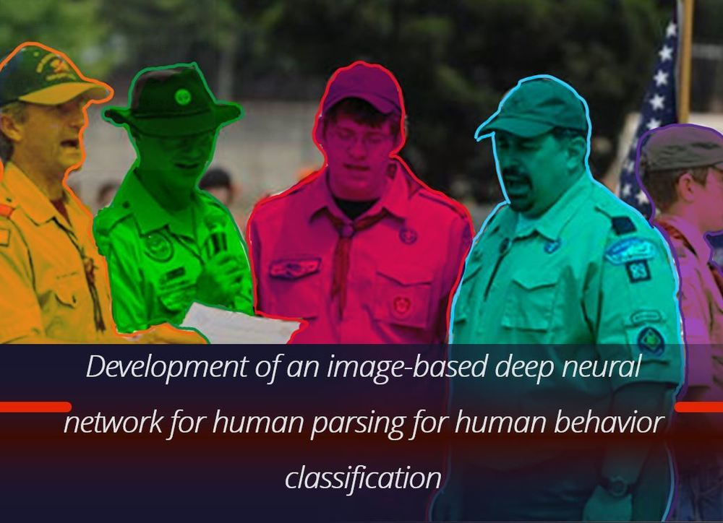





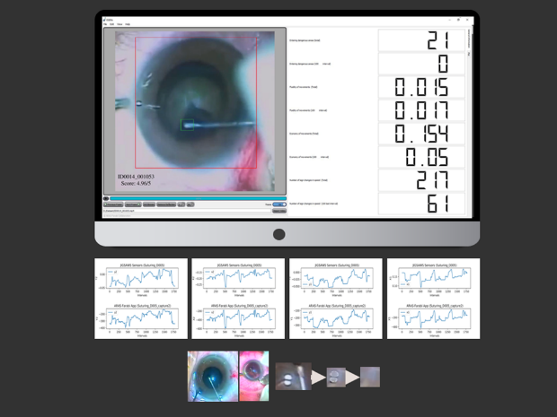
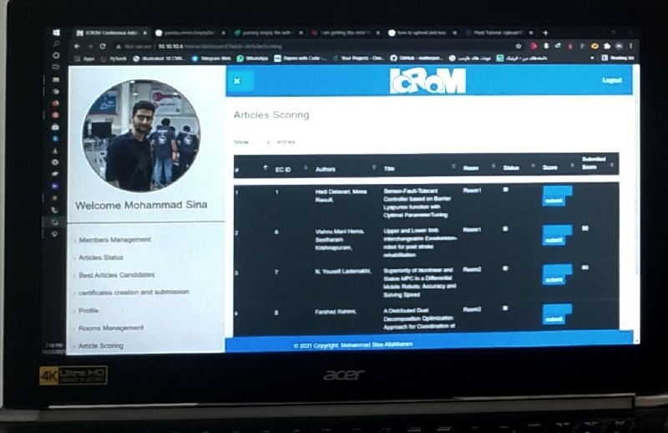
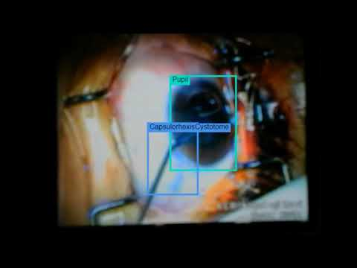
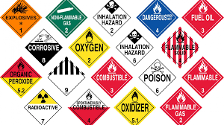
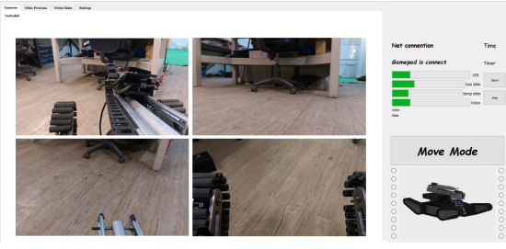
NOTABLE PROJECTS
Parsing-Detectron | A Deep Learning Framework
For Human Parsing Task
https://github.com/msinamsina/Parsing-Detectron
In this project, the Detectron2 framework has been modified. Parsing-Detectron can be used for either detection and segmentation tasks or human parsing tasks.
PyAutoMail | A Python Package For Large Scale Email Automation
https://github.com/msinamsina/pyautomail
https://pyautomail.readthedocs.io/en/latest/
This Python package can be used for easy email automation, and additionally, it has a Command-Line interface for creating email queues and sending personalized emails to your contact lists.
ESEL| Eye Surgery Evaluation and Labelling
https://drive.google.com/file/d/1oLa4BN6Livk69FaOX7VSaMq09awFhbCD/view
ESEL is a desktop application that can be used for evaluating Capsulorhexis Eye Surgery based on surgical videos. Furthermore, this application is used for semi-automated labeling in pupil and surgical instrument detection and tracing tasks.
Persian Chair | A Web Application For
Evaluating the Articles
The Persian Chair (PCH) is a Django web application developed in response to a request from the ICRoM Conference.
Django
ARAS Deep Learning Framework| A Deep
Learning Framework For object detection
https://github.com/msinamsina/ARAS-DeepLearning-FW
In this project, a deep learning framework has been created from scratch for the object detection task, specifically designed for detecting pupils and Capsulorhexis surgery instruments.
Hazmat Detection | Hazardous Materials (HAZMAT)
Sign Detection
In this project, a hazardous materials (HAZMAT) sign dataset was prepared and utilized to train YOLO for creating a hazmat detector.
Rescue Robot Remote Control APP | A GUI For
Tele-Operating of UGV Robot
This is a desktop application that provides a graphical user interface for controlling and interacting with the KN2C Rescue Robot. Additionally, this application includes several sub-applications capable of automatically handling tasks such as hazmat detection, path planning, and inverse kinematics for the 7-DOF robotic arm.

Slide 3









EXPERINCES
Freelancer | Self Employed
Software Developer
Computer Vision Expert
Full-Stack Developer
2023-Now
Computer Vision Researcher | ARAS Laboratory
Computer Vision Researcher
Machine Learning Researcher
Software Developer
2018-2023
Full Stack Developer | IT Team of ICRoM Conference
Software Developer
Full-Stack Developer
2018-2023
COO and Software-Hardware designer | Rahbin Sanat Nasir Company
Chief Operating Officer
Human Resources Management
Software-Hardware Designer
Computer Vision Expert
2022-2023
hardware developer | Ride-On company
Digital Electronics Engineer
Embedded Systems Developer
2017-2018
Team Leader, Software-Hardware developer | KN2C Robotic Team
Human Resources Management
Digital Electronics Engineer and Embedded Systems Developer
Software Developer and Desktop Application Designer
Junior computer vision engineer
2014-2018
ACHIVMENTS AND HONOR
Top Rank (Second Place) | In the undergraduate Level (M. Sc) 2023
IEEE Reviewer | Review in IEEE Transactions on Medical Robotics and Bionics 2023
Third place | RoboCup Asia-pacific Rescue robot league 2018
Third place | Iran Open Rescue robot league 2017, 2018
Second place | ICRoM Creative Exhibition 2016
Fifth place | RoboCup Rescue robot league 2017

Slide 4


PUBLICATIONS
https://scholar.google.com/citations?user=ejhATTMAAAAJ&hl=en
ARAS-Farabi Experimental Framework for Skill Assessment in Capsulorhexis Surgery https://ieeexplore.ieee.org/document/9663494/ This article proposes a new dataset for Capsulorhexis Surgery and introduces a new deep learning framework.
Surgical Instrument Tracking for Capsulorhexis Eye Surgery Based on Siamese Networks https://ieeexplore.ieee.org/document/10025355/ Surgical instrument tracking is a challenging task that can be used for evaluating surgeon performance. This paper presents a new method for tracking surgical instruments during Capsulorhexis Surgery.
Closed-form Inverse kinematics Equations of a Robotic Finger Mechanism https://ieeexplore.ieee.org/document/9663448 Obtaining closed-form inverse kinematics equations for serial arms with arbitrary structures is a challenging task. However, this article proposes closed-form inverse kinematics equations that can be used for a large group of serial robots with fewer than 5 links.
RoboCup rescue 2017 team description paper KN2C https://robocup-rescue.github.io/team_description_papers/2017/Champ2017_Iran_KN2C.pdf This article introduces a UGV Robot designed with a focus on minimizing reliance on prebuilt parts (both electrical and mechanical) and reducing the total cost, not only for robotic competitions but also with the goal of later global use in rescue missions.
TEACHING EXPERINCES
Computer Vision & Deep Learning Course | ARAS Academy 2022
Robotics for kids | ARAS Academy 2019
Teacher Assistance of Robotics Course |K. N. Toosi university of Technology 2017,2016
Teacher Assistance of Micro-Processors Course | K. N. Toosi university of Technology 2015
Electronic in robotic | KN2C Laboratory 2016
Robotics for kids | Seyidkhandan neighborhood hall 2017

